Slide 1
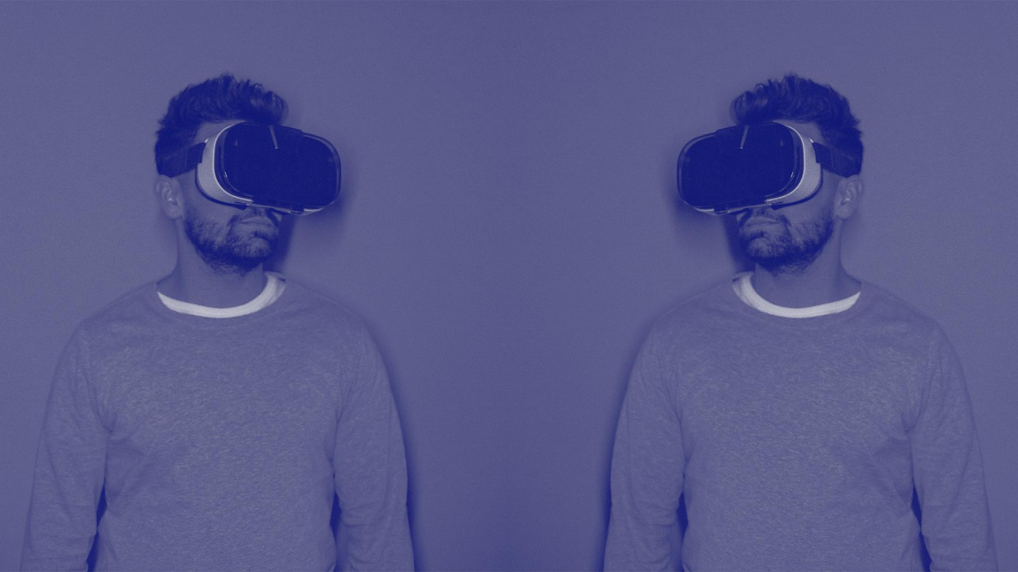
Discover Your Dream Space // Immersive Real Estate at Your Fingertips
VRchiTURE
Architecture and home design of the future, embracing 3D and VR.
Raul SARBU
Raluca TRANDAFIR
Bogdan TATU
Eliza CIOVICA
Diana MISCUTA

Slide 2
WHY VRchiTURE?
01.
03.
02.
Real Estate Market Inefficincies
Improve the experience of designing and visualizing custom homes
Time-Consuming property visits
Ineffective remote showcasing
Revolutionize the home buying process
Helping clients understand their future homes better
Enhancing communication between clients and designers
Improving user experience
Empowering better decision-making
Notes:
Why did we choose this?
We chose this idea to address the challenges in the traditional real estate market, such as time-consuming property visits, limited visualization of custom home designs, and the difficulty of showcasing properties remotely.
With this project, we will revolutionize the home buying process
Our platform will transform the home buying experience by offering an efficient and immersive alternative to traditional property viewings, empowering buyers to make better decisions.
Our goal is to improve the experience of designing and visualizing custom homes
We will do this by helping clients and designers visualize and understand custom home designs better, resulting in improved communication and fewer misunderstandings.

Slide 3
THE PROBLEMS
01
02
03
Limited visualization of custom home designs
Difficulty in showcasing properties remotely
Process of searching for a home
Notes:
So these are the problems that we want to solve and we will go through each of them

Slide 4

THE PROBLEMS
01
Process of searching for a home
Countless hours long process
9 months average time to find a house
Inefficient for both agents and buyers
Notes:
Traditional home searching often requires countless hours of in-person visits, which can be inefficient and exhausting for both buyers and agents.
The median time for finding a house is 9 months. Just think about how many ways people could spend that much time

Slide 5
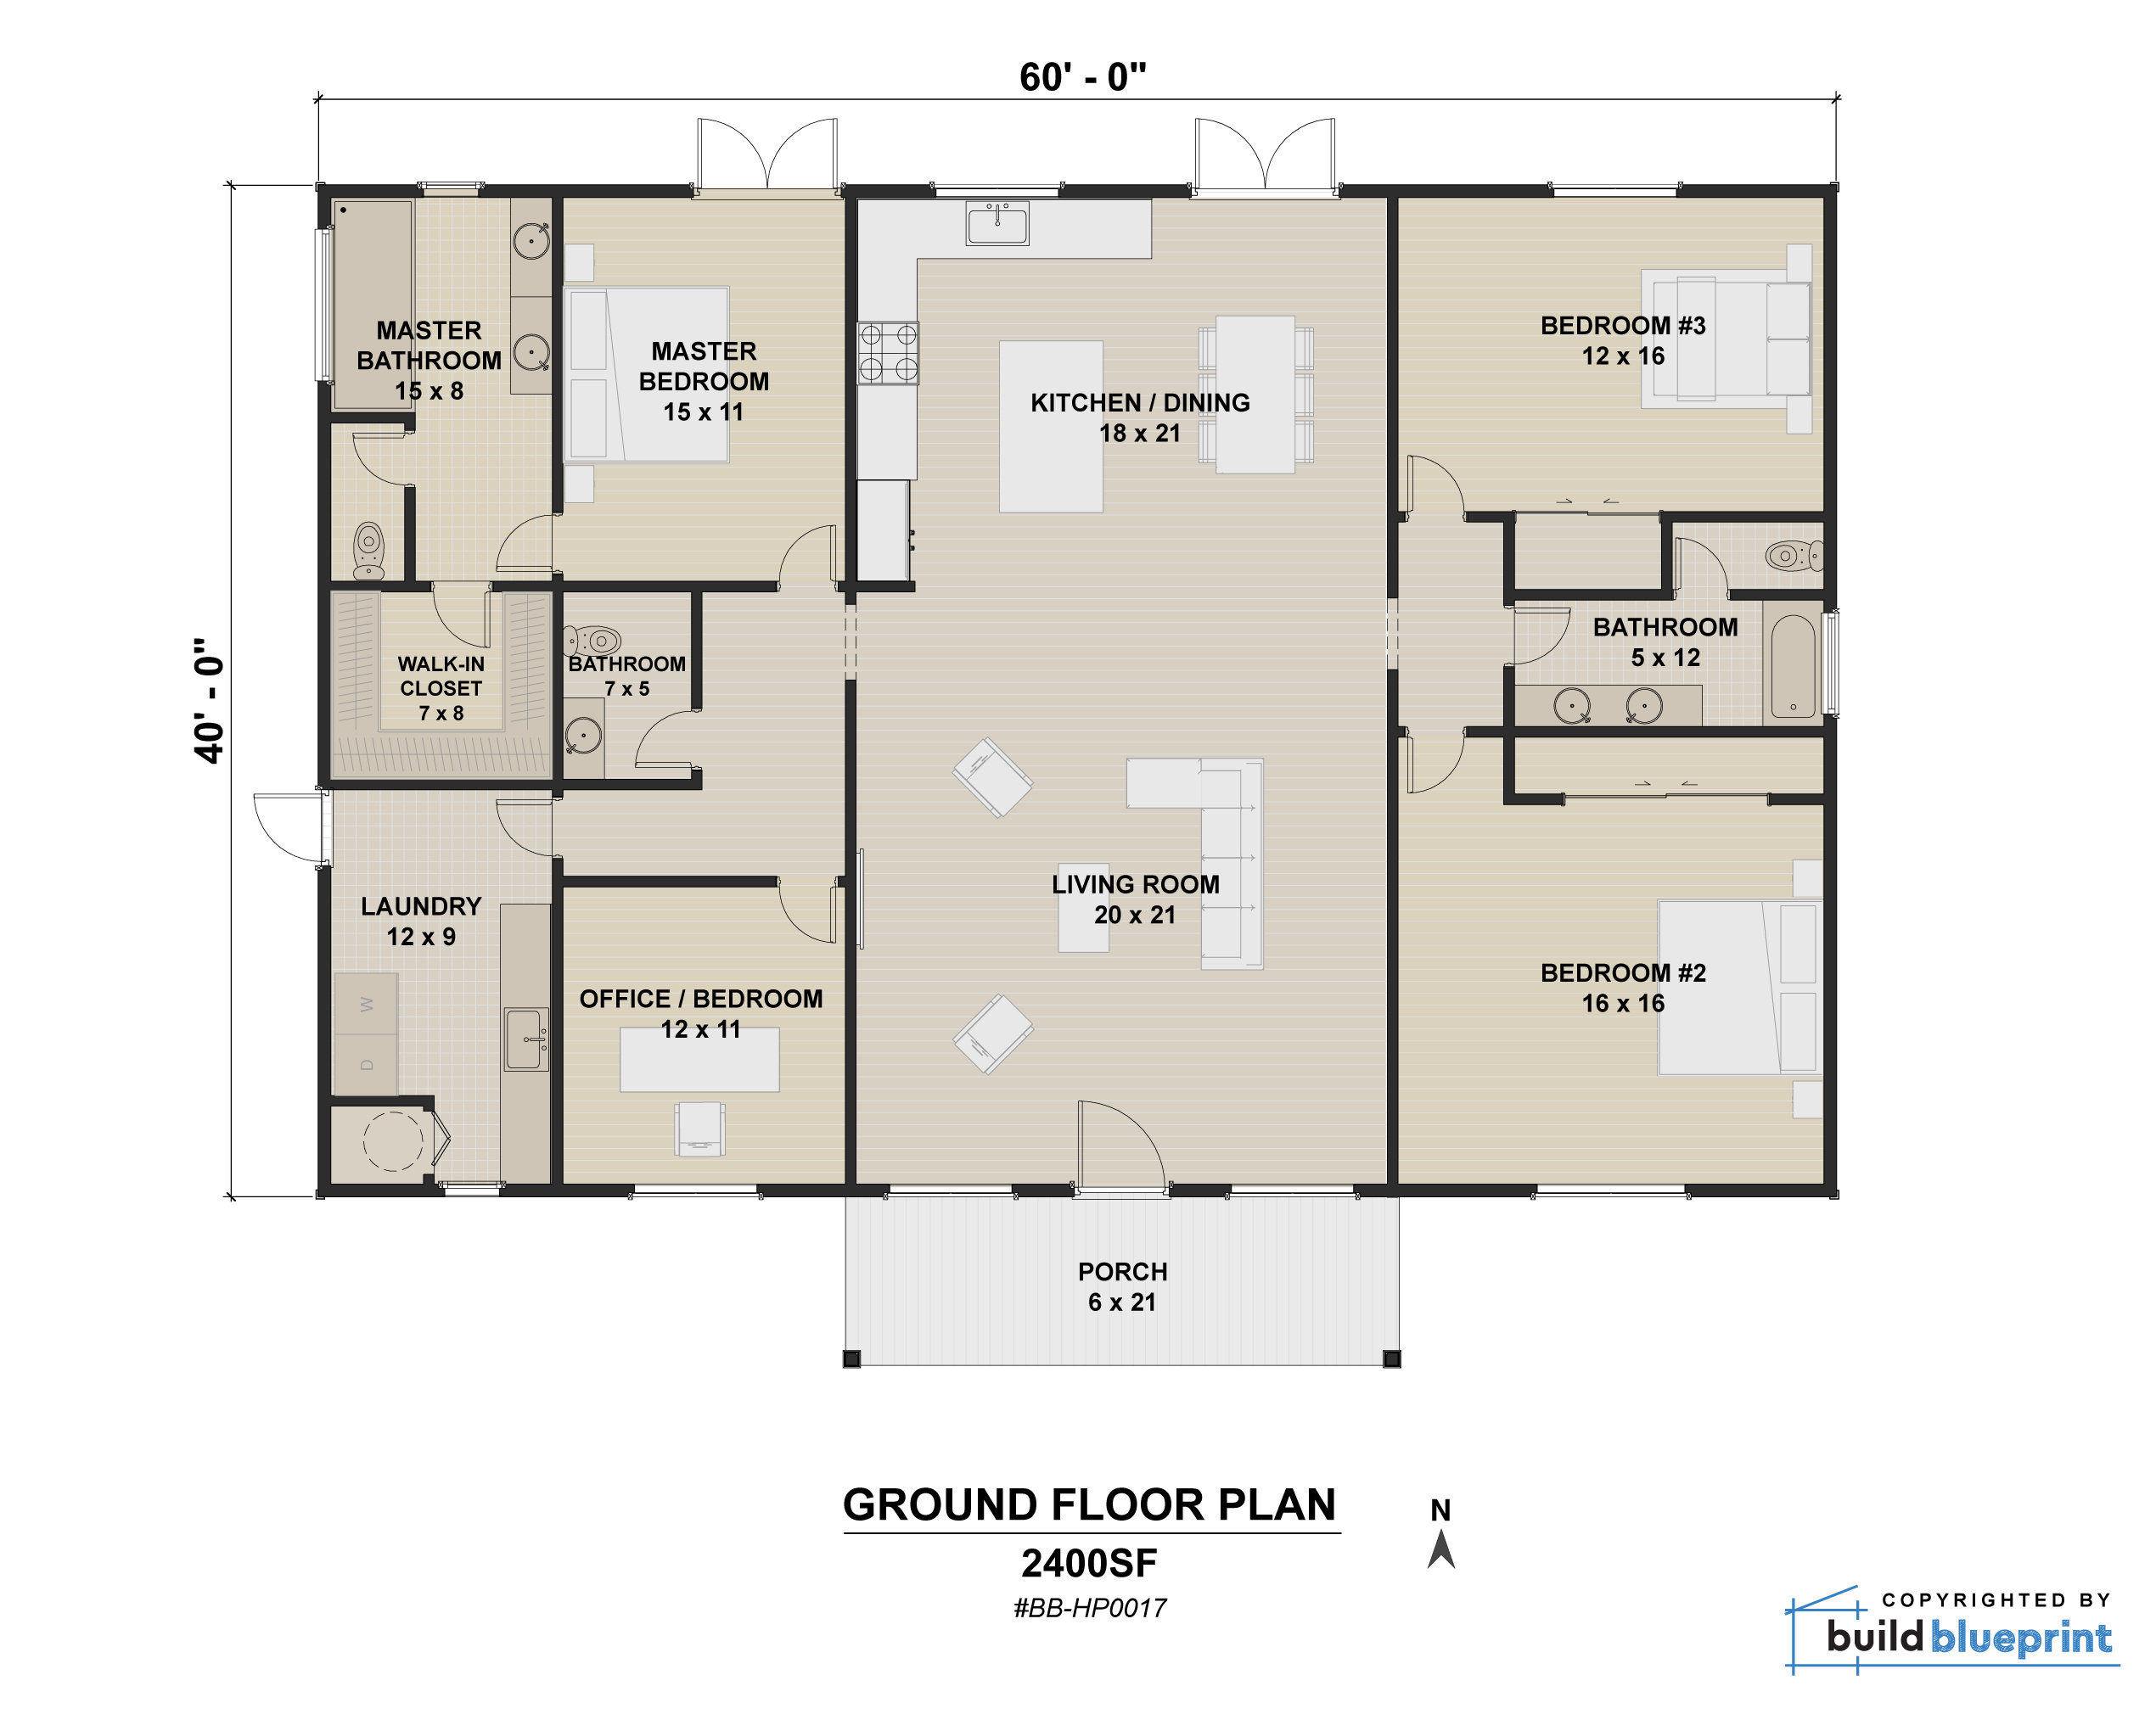
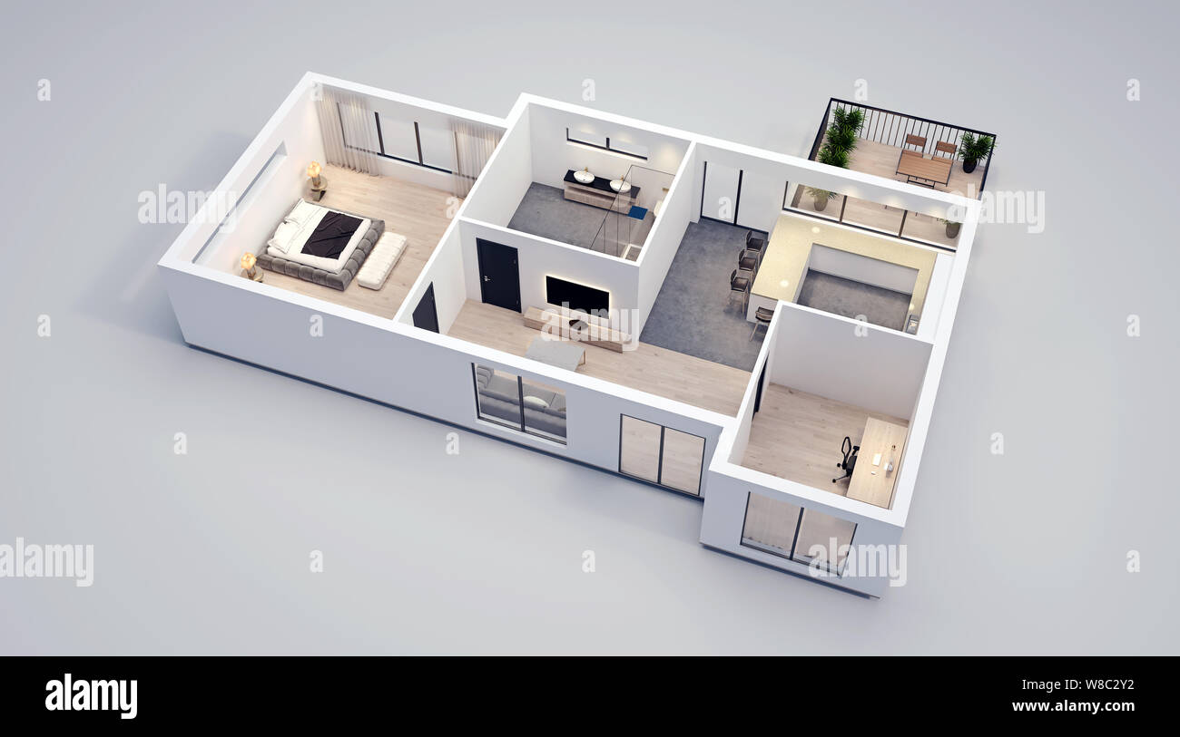
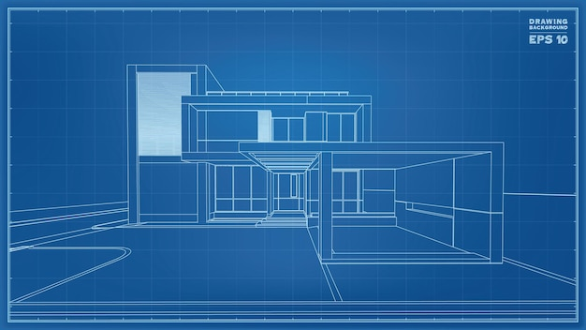
THE PROBLEMS
02
Limited visualization of custom home designs
2D blueprints make it difficult for clients to grasp the final look
This may lead to disappointment
Notes:
Although 2D blueprints and renderings exist, they can make it difficult for clients to grasp the true look and feel of their future homes, leading to potential disappointment and costly revisions.

Slide 6
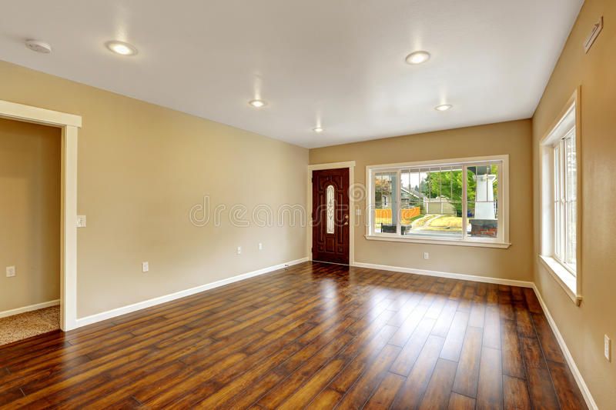
THE PROBLEMS
03
Difficulty in showcasing properties remotely
Traditional photos and videos do not provide a realistic and immersive experience for remote property viewings
This limits the effectiveness of remote property showcasing.
Notes:
Traditional photos and videos often fail to provide a realistic and immersive experience for remote property viewings, limiting the effectiveness of remote property showcasing.

Slide 7
THE SOLUTION
01
02
03
Efficient and immersive home search experience
Enhanced visualization of custom home designs
3D scanning and VR platform
Notes:
Now we will go through the solutions that we are proposing

Slide 8
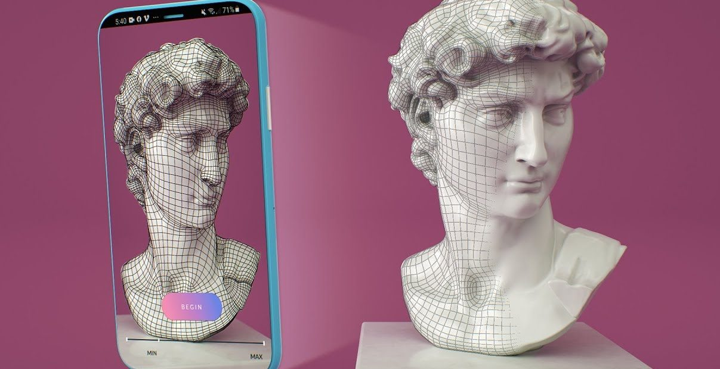
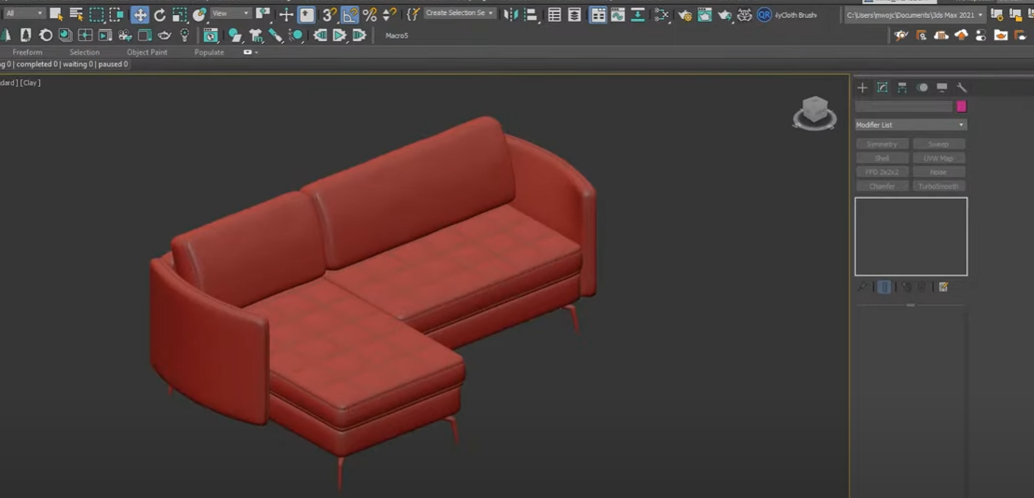
THE SOLUTION
01
3D scanning and VR platform
Software that seamlessly integrates 3D scanning and VR technologies
Notes:
Our software integrates 3D scanning and virtual reality technologies, offering an innovative solution to the problems faced in the traditional real estate market.
The iPhones today already have a LIDAR scanner so that makes it easy for real estate agents to scan a property which they can export into our software.

Slide 9
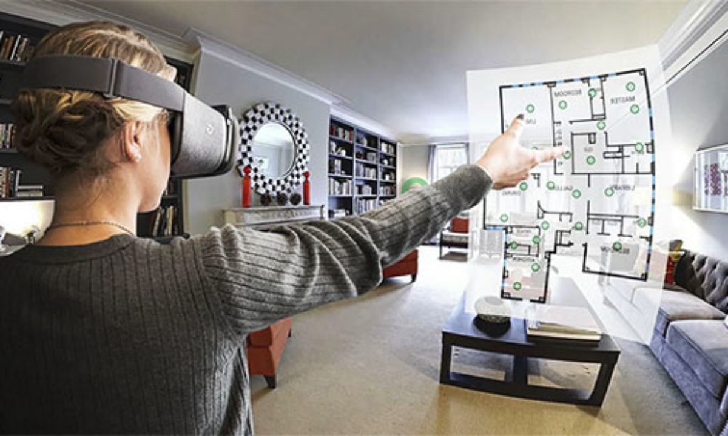
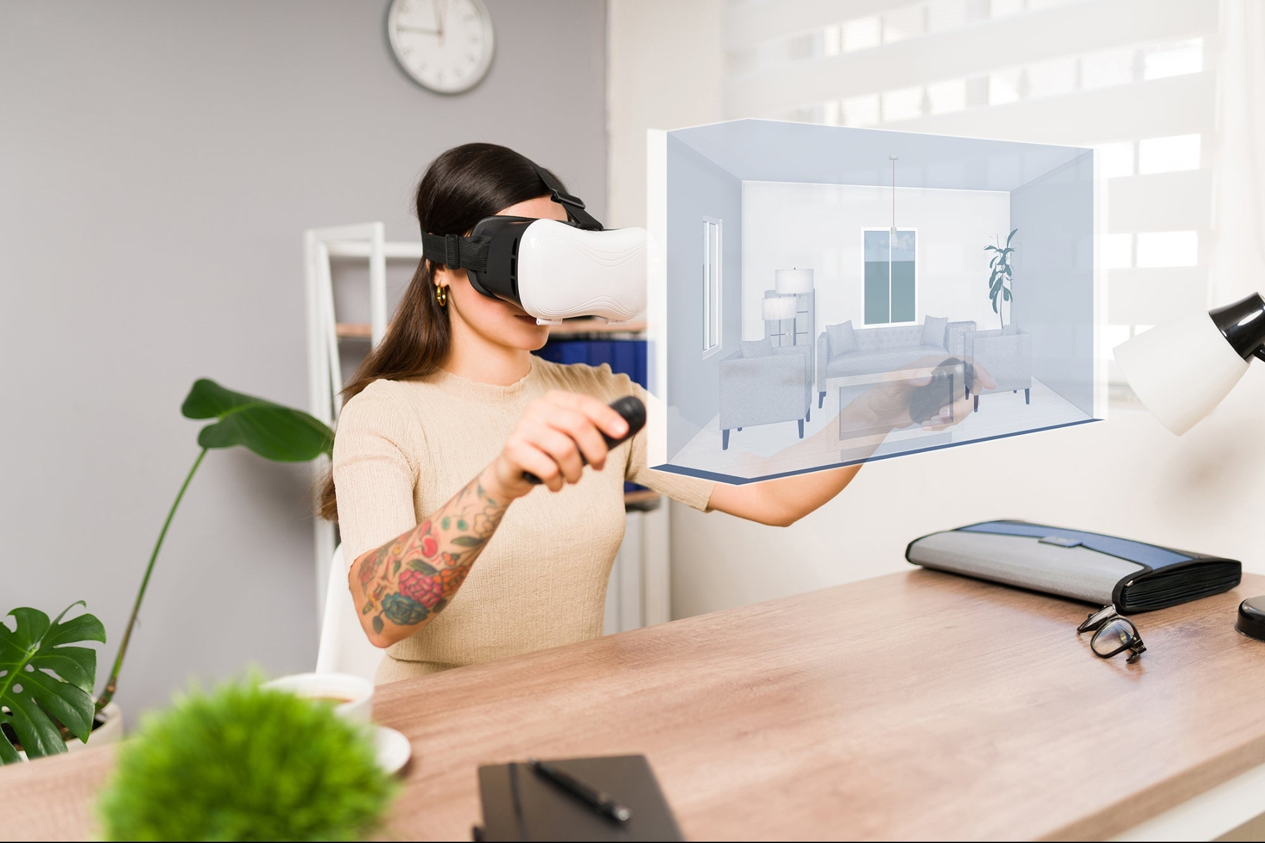
THE SOLUTION
02
Efficient and immersive home search experience
Reduced time spent on property visits
More engaging remote viewings
Notes:
Our platform allows users to explore properties in VR, providing an engaging and time-saving alternative to in-person visits and what I want to emphasize more, it makes the remote viewing more engaging which can lead to customers being more likely to buy the property if they can see it firsthand and even customize it to their liking.

Slide 10
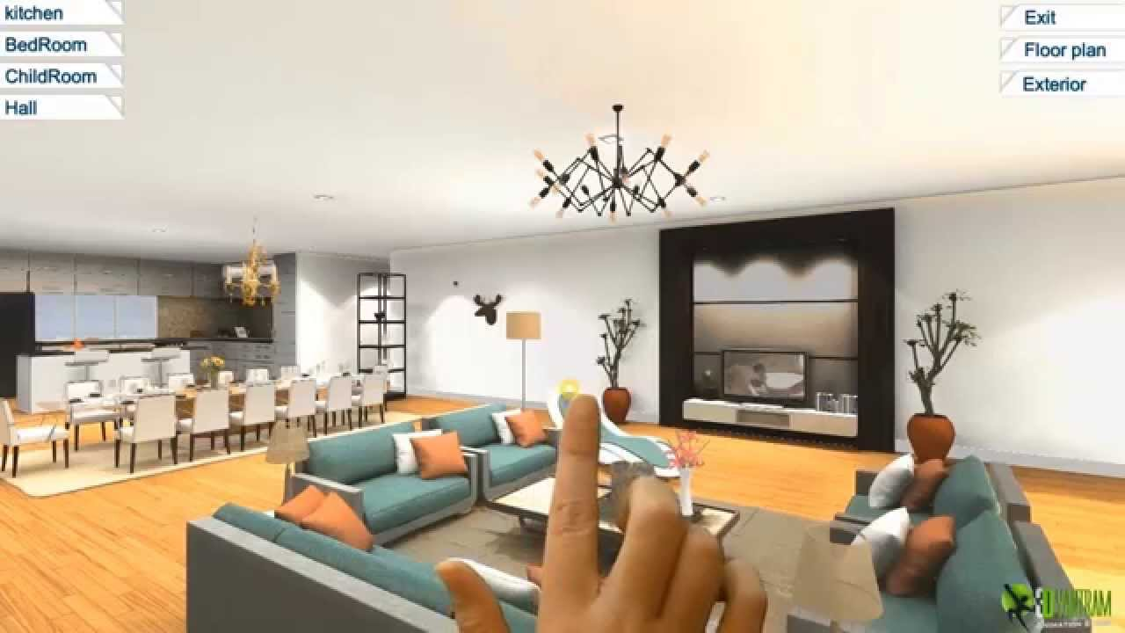
THE SOLUTION
03
Enhanced visualization of custom home designs
Clients can "walk through" their future homes in VR
Notes:
And finally, by allowing designers and architects to create VR home models, clients can gain a deeper understanding of their future homes and avoid potential misunderstandings and costly revisions.

Slide 11

THE PRODUCT
What is VRchiTURE?
Notes:
VRchiTURE is a platform made out of 2 parts as we will see on the next slides, which allow the user to visualize in his desired site in a virtual environment.

Slide 12


WHAT DO WE OFFER?
SCAN THE SITE Scan your place/future place plans.
EXPORT THE PLAN Turn it into virtual reality.
PUT ON YOUR GLASSES Use designated glasses to visualize.
ENJOY Watch your dream come true.
Notes:
This is what we basically offer. And I will explain one by one every point.

Slide 13

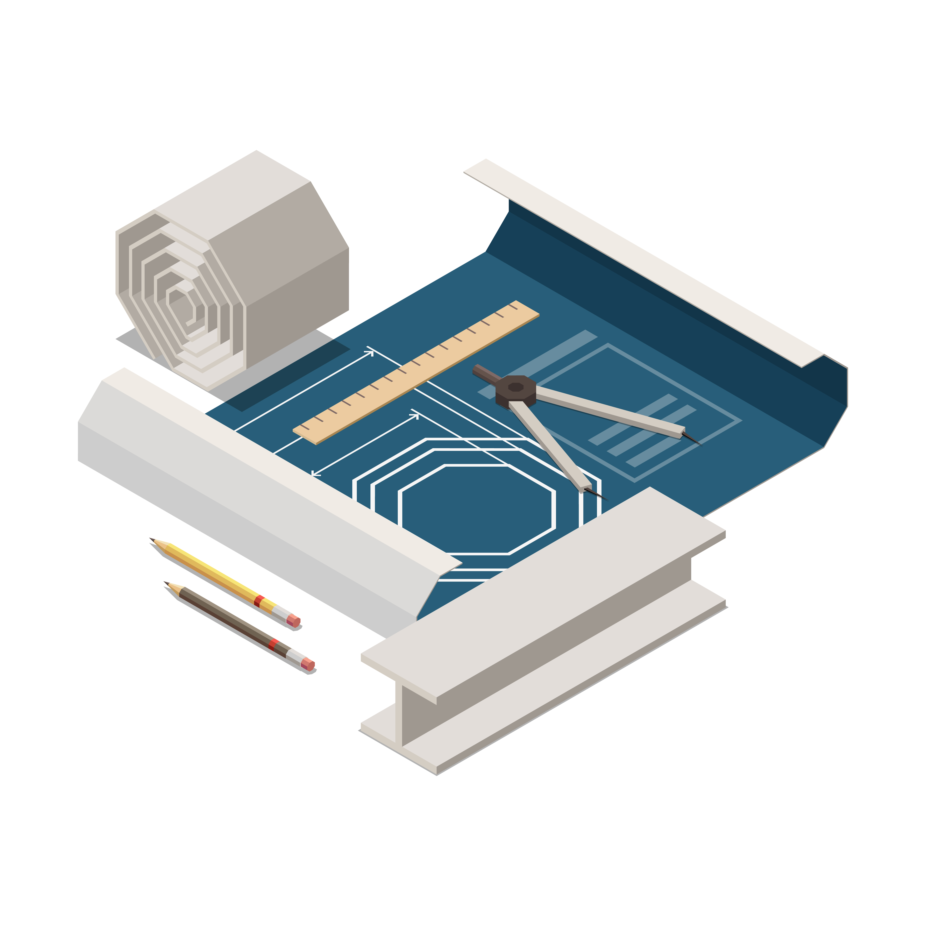
WHAT DO WE OFFER?
SCAN THE SITE
ACCESS THE MOBILE APP.
SCAN YOUR PLACE.
SCAN FUTURE PLACE PLANS.
Notes:
First, we provide a mobile application that can be used either to scan the actual property or to scan architectural plans.

Slide 14


WHAT DO WE OFFER?
EXPORT THE PLAN
SEND PLANS TO AN ONLINE PLATFORM.
RENDER TO VR FORMAT.
Notes:
Then, when you are ready with the scans, export the files to our online platform which will render them in a VR format. The files will be automatically associated to your account and will be able to see them after exporting.

Slide 15
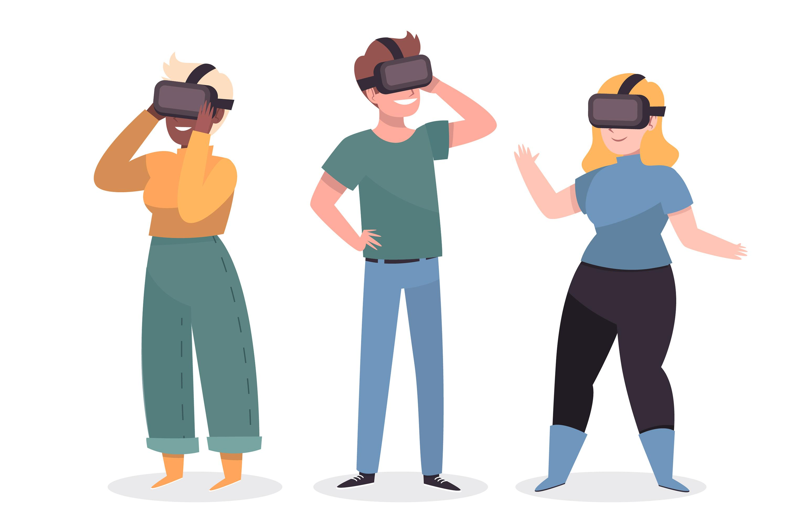
WHAT DO WE OFFER?
PUT ON YOUR GLASSES
USE DESIGNATED GLASSES TO VISUALIZE.
Notes:
The exported file can then be visualized using special designated glasses for Virtual Reality.

Slide 16

WHAT DO WE OFFER?
ENJOY
WATCH YOUR DREAM COME TRUE.
MODIFY THE PLANS.
Notes:
Now you can live your dream place before actually living it. Enjoy the virtual reality ahead of your eyes and, depending on the plan, also modify it to better suit your needs.

Slide 17
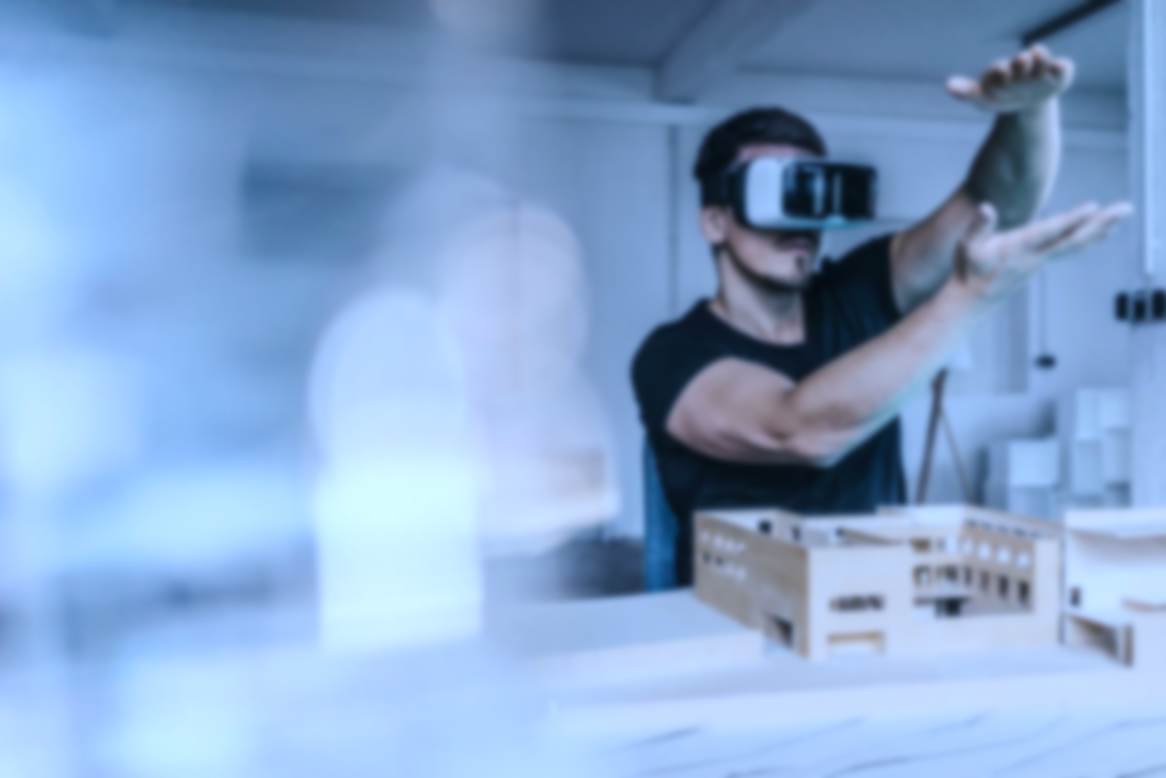
MARKET ANALYSIS

Slide 18


THE COMPETITION
REAL ESTATE AGENCIES
Notes:
Now, let’s look at the competition
First off, we have traditional real estate agencies, which are obviously
Then we have online real estate platforms, like Zillow, Redfin, Realor.com, etc. which aggregate user-posted houses and apartments and have a lot of useful tools to make the process easier, but through which you can only see pictures or request a physical tour of the place
These 2 have a massive drawback that being that they only specialize in the market of real estate
Finally, we have VR / AR Companies, the most notable of which being Matterport, that already has established partnerships with some of the aforementioned online platforms

Slide 19



THE COMPETITION
ONLINE PLATFORMS - Zillow
- Redfin
- Realtor
Notes:
Now, let’s look at the competition
First off, we have traditional real estate agencies
Then we have online real estate platforms, like Zillow, Redfin, Realor.com, etc. which aggregate user-posted houses and apartments and have a lot of useful tools to make the process easier, but through which you can only see pictures or request a physical tour of the place
These 2 have a massive drawback that being that they only specialize in the market of real estate
Finally, we have VR / AR Companies, the most notable of which being Matterport, that already has established partnerships with some of the aforementioned online platforms

Slide 20
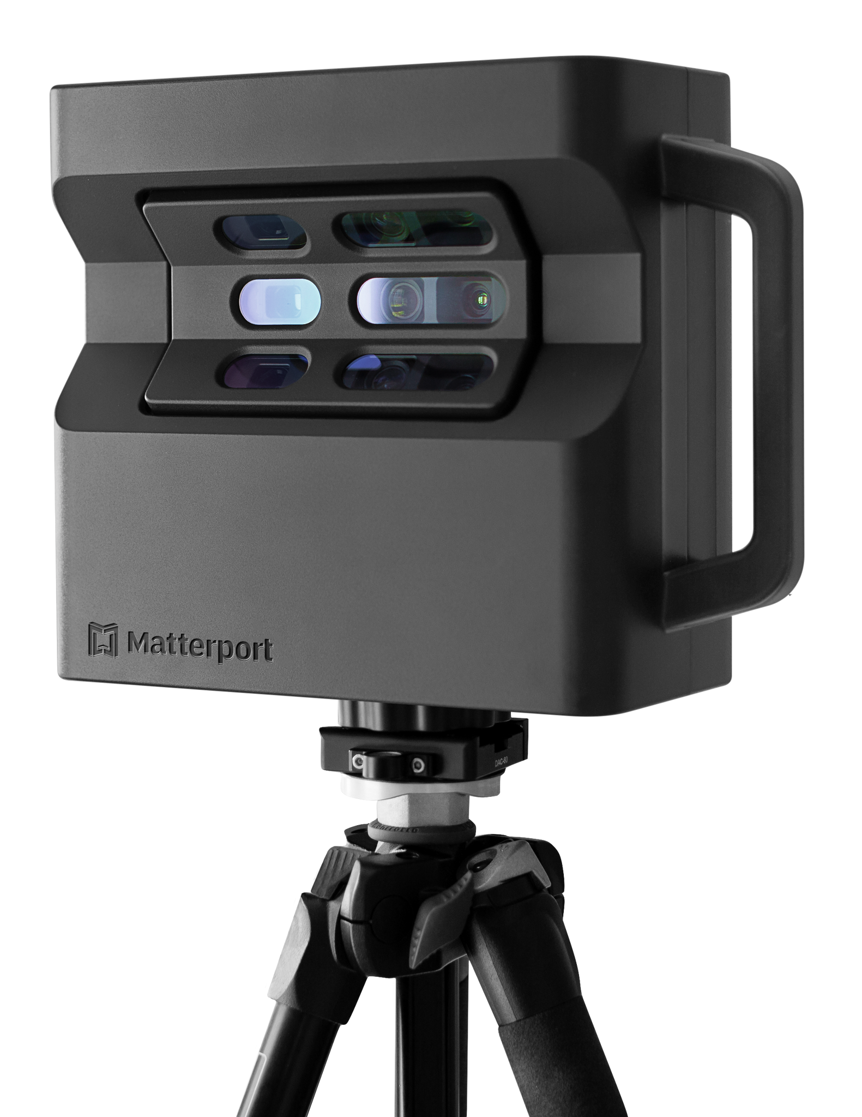

THE COMPETITION
VR / AR COMPANIES - Matterport
Notes:
Now, let’s look at the competition
First off, we have traditional real estate agencies
Then we have online real estate platforms, like Zillow, Redfin, Realor.com, etc. which aggregate user-posted houses and apartments and have a lot of useful tools to make the process easier, but through which you can only see pictures or request a physical tour of the place
These 2 have a massive drawback that being that they only specialize in the market of real estate
Finally, we have VR / AR Companies, the most notable of which being Matterport, that already has established partnerships with some of the aforementioned online platforms and has their own proprietary camera and scanner

Slide 21
DIFFERENTIATORS
*
*
*
Unique combination of 3D scanning and VR
Enhanced user experience
Scanning of properties/furniture
Virtual tours
Custom home design features
Seamless integration
Personalized service
Immersive property viewing
Improve interior home design
Allow for modifications
Notes:
So, what differentiates us from the competition?
A unique combination of the 3D scanning software and virtual reality that allow the users to scan their property in order to have virtual tours, or to scan furniture to help in the renovating process
Enhanced user experience through the seamless integration of the VR software and hardware and the mobile platform used for scanning and storing designs
Custom home design features that not only allow for scanning but can be subsequently used to modify the underlaying architecture and even the interior design of the house

Slide 22
TARGET CUSTOMERS
01.
02.
03.
Real Estate Agents, Brokers, Property Managers
Scan already owned real estate
Improve services to reach more clients
Architects
Create 3D models and home designs
Make changes before construction begins
04.
Interior Designers
Showcase design ideas
Visualize and alter the product to suit client’s needs
Homeowners
Renovate or redesign homes
Notes:
By adopting our platform, agents and agencies can scan their already owned real estate and give virtual tours to potential customers
Architects can leverage our platform to create VR models of custom homes, to show clients the finished product and also allowing them to make changes before construction begins
Interior designers could be another target for our company, showcasing their design ideas to clients to better visualize their design concept and alter the product to better suit the client’s needs
Homeowners who are planning to renovate or redesign their homes

Slide 23
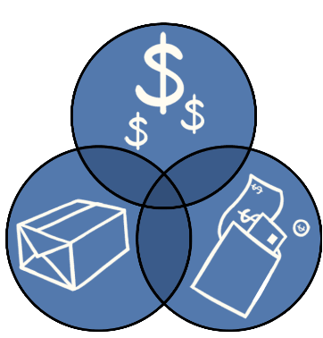
WHAT IS THE PLAN?

Slide 24

LIMITED EDITION
Limited library of objects
Limited space to create (max 500 sq ft)
Limited storage space
Maximum of 3 saved models
FREE TRIAL
30 days

Slide 25
ALL AVAILABLE OPTIONS
$750 – Annual subscription
Full library of objects
Over 600 sq ft for bigger houses
Up to 500TB storage space
Unlimited saved models
PAID SUBSCRIPTION
Regular updates and Support

Slide 26
EXTRA TOOLS
$1,000 – Annual Subscription
Additional designs
Exclusive materials
Exclusive textures
PREMIUM FEATURES
Extra storage space (1TB)
Training Live and Video Sessions
Personalized objects

Slide 27




SCALABILITY
Cloud-based infrastructure
Contribution Growing
Constant innovation in VR

Slide 28
THE TEAM
1
2
5
2
Project Manager
BAs
Developers
QAs
2 Backend
2 Frontend
1 VR

Slide 29
REVENUE STREAMS
01.
03.
02.
Subscription fees
Custom development services
Our primary revenue stream
Ensures recurring revenue and financial stability
Premium feature add-ons
Additional revenue stream
Broadens our market reach
Additional revenue stream
Helps to further increase our platform's profitability
Notes:
Our primary revenue stream comes from subscription fees paid by real estate agents and agencies, ensuring recurring revenue and financial stability.
Additional revenue will be generated from users who opt for premium features, helping to further increase our platform's profitability.
We will also offer custom development services for specific clients, such as large real estate developers, creating another revenue stream and broadening our market reach.

Slide 30
COST STRUCTURE
01
02
03
Platform development and maintenance
Marketing and sales
Customer support and training

Slide 31

COST STRUCTURE
01
Platform development and maintenance
hiring developers
acquiring necessary hardware resources
acquiring necessary software resources
Notes:
This is the largest expense, as it involves developing and updating our software application, as well as maintaining the necessary infrastructure to support it.
We estimate that this will account for 50% of our total expenses.

Slide 32


COST STRUCTURE
02
Marketing and sales
promoting the platform to target customers
attending industry events
advertising

Slide 33

COST STRUCTURE
03
Customer support and training
providing timely assistance
offering training materials
workshops

Slide 34
SUBSCRIPTION FEES
Free trial | $0 / 30 days
Basic subscription plan | $750 / year
Premium subscription plan | $1,000 / year

Slide 35
FINANCIAL PROJECTION
1,000 subscribers average of $900/user
$900,000 revenue $450,000 net profit
25% growth of subscriber base / year average of $1200/user
$4.2 million revenue $2.1 million net profit
1
5

Slide 36
CURRENT FINANCIAL SITUATION
 | Expenses
Equipment | $65,000
Salaries and benefits | $35,000
Rent and utilities | $15,000
Maintenance | $7,500
Total | $122,500

Slide 37
WHAT DO WE ASK FOR?
$110,000 for 20%
Purchasing VR equipment, software licenses and maintenance team
Hiring additional staff for researching new integration techniques with VR/AR
Marketing and advertising for increasing customer reach
→ $60,000
→ $30,000
→ $20,000

Slide 38

THANK YOU!

